Slide 1
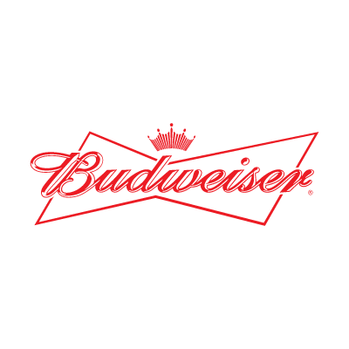

Case Study: An Analysis of Brewery and Beer
Customer: Budweiser
Presenters: Adam Alidra and Cameron Stewart
Notes:
Budweiser Executive Leadership, hello- thank you for taking the time today to meet. Adam and Cameron represent A&C Data Consulting Partners.
Today, we’re delivering our case study, an analysis of brewery and beer across the US based off the provided data sets by your team.

Slide 2
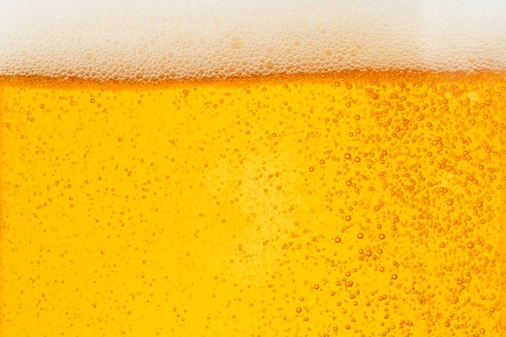

Agenda
Executive Summary
Breweries by the Number
Analyzing Missing Values
Median ABV & IBU by State
Maximum Values and ABV Distribution
ABV to IBU Relationship
Machine Learning- Predicting Style
kNN Classification
NaiveBayes Analysis of Beer Types by ABV & IBU
Summary, Proposal and Next Steps

Slide 3
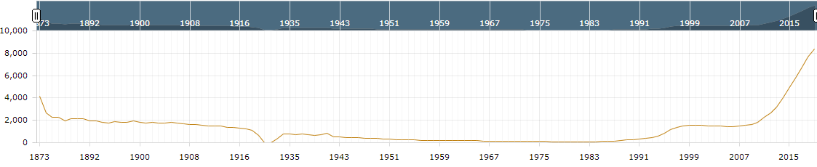
Executive Summary
Macro Findings of US Breweries and Beers Data Sets:
The Breweries listed are all US Breweries and all Beers listed are Craft Beers
The data references 51 states (Washington D.C. included as a ‘state’)
US Brewery and Craft Beer Market Public Data-at-a-Glance:
U.S. beer volume sales down 2% in 2019, while craft brewer sales continued to grow at rate of 4% by volume¹
Craft brewer sales reached 13.6% of the U.S. beer market by volume¹
Historical U.S. Brewery Count¹
¹https://www.brewersassociation.org/statistics-and-data/national-beer-stats/#:~:text=Summary,grew%20the%20most%20for%20taprooms.

Slide 4
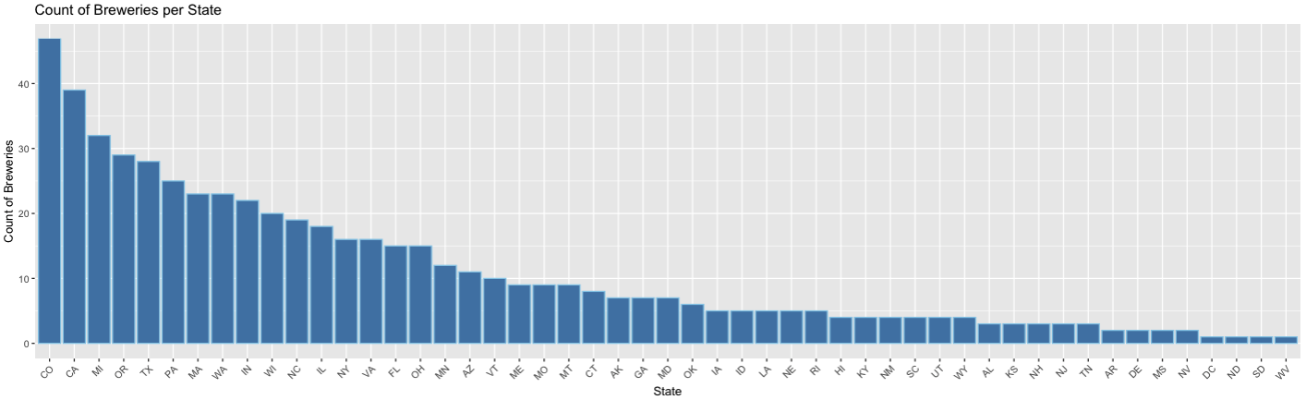
Breweries by the Numbers
Findings:
558 Total Breweries listed in the Breweries data set
Top 25% of states contain over 60% of the Breweries
CO and CA have the most Breweries in total

Slide 5
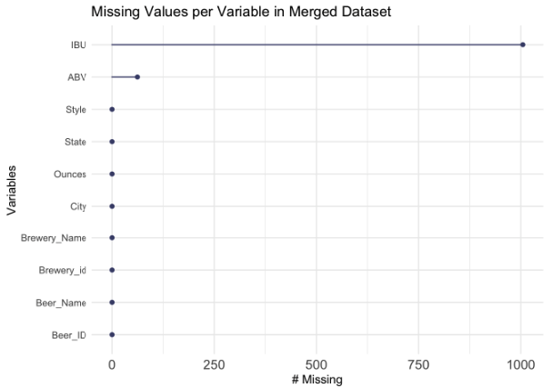
Analyzing Missing Values
Findings:
No NA values in Breweries data set
Merged data sets produce a combined 1067 NA values (all of which are found in the Beer data set)
1005 NA values are from the IBU column
62 NA values are from the ABV column

Slide 6
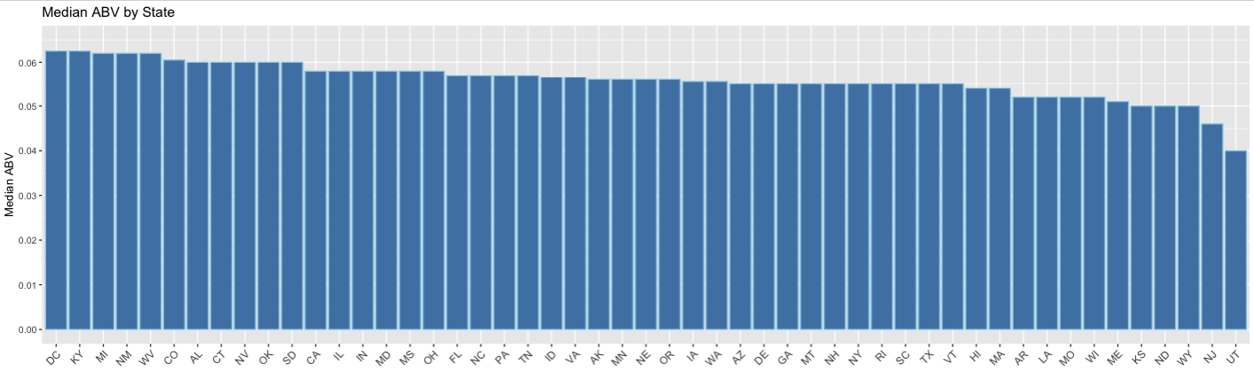
Median ABV by State
Findings:
DC and KY are tied for the highest ABV at 6.25%
UT has the lowest median ABV by a significant margin at 4.00%
84% of states have a median ABV between 5% - 6% (inclusive)
Notes:
Mention ABV is Alcohol by volume and what values mean
Mention DC and KY are tied for the highest
The variation between most of the states is rather small
Indicated by 84% of the medians lie between 5-6%
Mention UT has the lowest (I would theorize cultural factors are driving this)

Slide 7
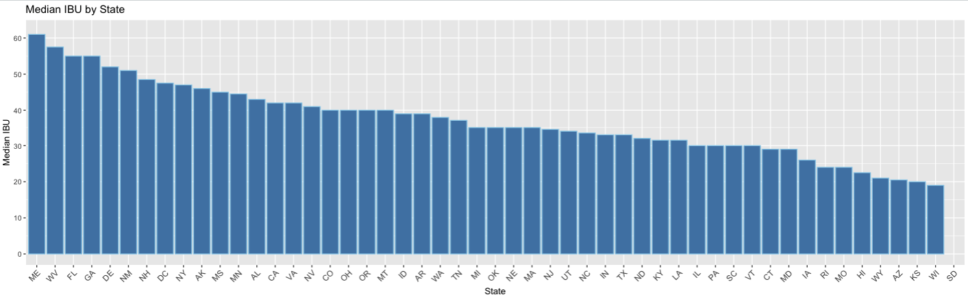
Median IBU by State
Findings:
ME has the highest median IBU
WI has the lowest median IBU
SD has no IBU data in the provided data sets (shown without bar below)
Notes:
Mention IBU and what values mean
Looking at the data we can see ME has the highest IBU and WI has the lowest median
Overall we can see a steady decline from approximately an IBU of 60 to an IBU of 20
This data has a bit more range than ABV
SD NAs

Slide 8
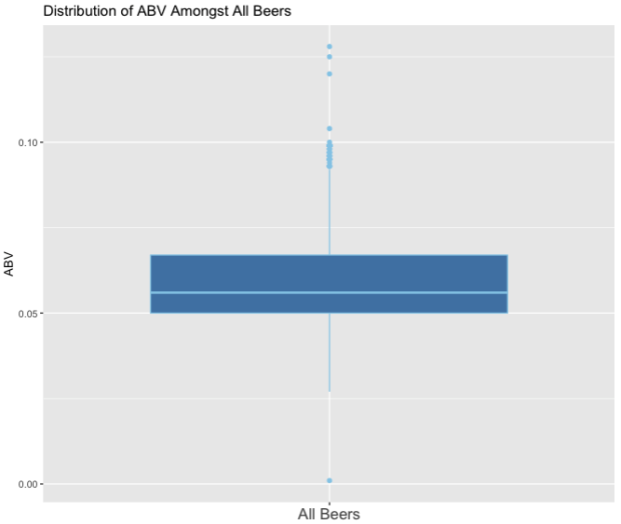
Maximum Values and ABV Distribution
Maximum Values:
Oregon’s Bitter Bitch Imperial IPA has the highest IBU of 138
Colorado’s Lee Hill Series Vol. 5- Belgian Style Quadrupel Ale has the highest ABV at 12.8%
ABV Distribution Findings:
The box plot is slightly right skewed which signifies higher dispersion in ABV in Q3 and Q4
Median ABV amongst all analyzed beers is 5.6%
There are significantly more outliers at the higher end of ABV than the lower end
Small subset of ABV outliers in top quartile hovering at or just below 10% ABV
Notes:
Max values – what are they for
ABV Distribution
Box plot
Slightly right skewed with median of 5.6% (in other words data is closer to lower end of ABV/IBU than higher end
Outliers on upper end
Cluster of outliers around just below 10%

Slide 9
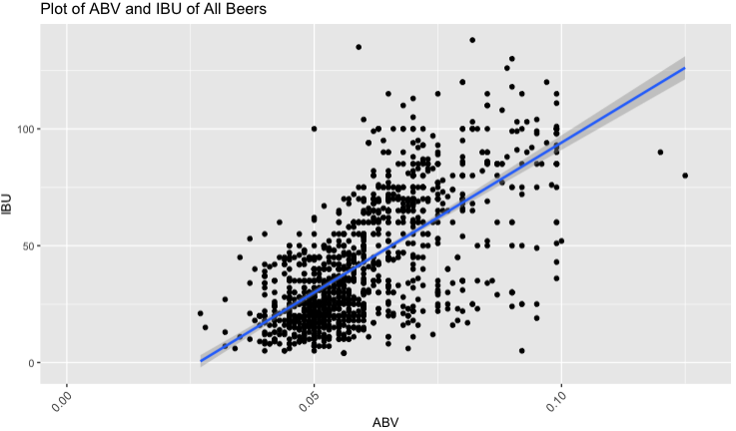
ABV to IBU Relationship
Findings:
As ABV increases (x-axis), the IBU value (y-axis) also tends to increase showing a moderate relationship (R = 0.67)
45% of the variability in IBU can be explained by ABV (and vice versa)
Further investigation into to the effect of Style on ABV and IBU variables would likely improve prediction capability
Notes:
Axis definitions
Positive trend
Moderate relationship based on the R-value 0.67
Using R^squared we know that 45% of the variability in IBU can be explained by ABV (and vice versa)
Beer style is another factor likely driving variation in these two factors

Slide 10
Machine Learning- Predicting Style
Notes:
In this next section we apply two different, widely used machine learning models, kNN and NaiveBayes to ascertain insights respective to the ABV & IBU values of beers by style.

Slide 11
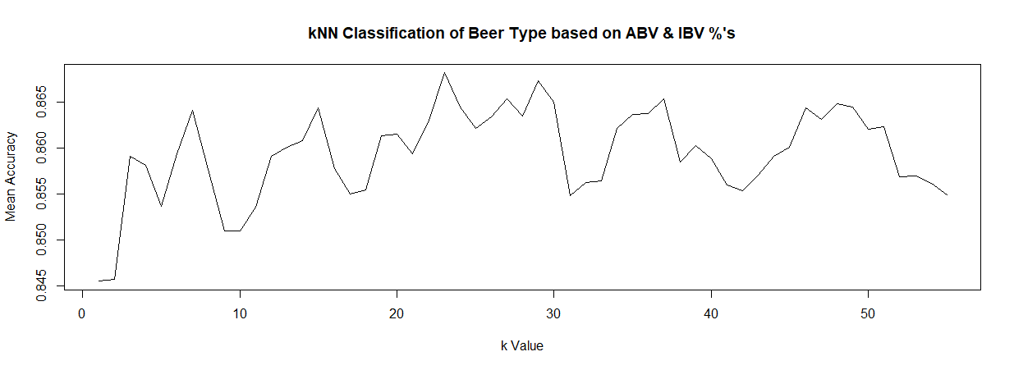
k-NN Classification of Beer Types by ABV & IBU %’s
Sample size of 944 beers tested 15 times for every k from 1 to 55
Scope: IPA and Other Ale Style
K=23
Result: Mean Accuracy of 86.81% (or 820) discrete beer styles classified correctly based on provided ABV & IBU
IPA’s were correctly identified (sensitivity) 84.18% of the time, while Other Ales were correctly classified 86.41%
Using a Leave-One-Out Cross Validation kNN model to produce 1.74x more accuracy than standard model
Notes:
Let me briefly lay a foundation here- machine learning is based on generalizing empirical data against unseen or unprovided data points. For kNN, we use the test data to determine the right value of K and train the nearest neighboring values ultimately to help us understand the accuracy that, in this case, a beer style corresponds to the ABV & IBU values of a beer type.
For this exercise, we wanted to deliver the highest accuracy, so we used a cross-validation technique which splits the data into 3 parts, test, train, and cross-validation data.

Slide 12
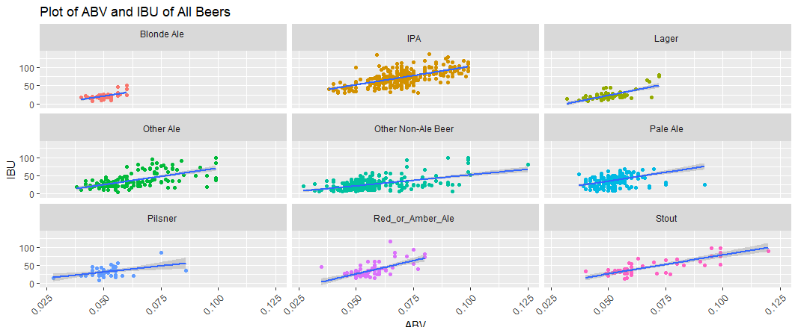
NaiveBayes Analysis of Beer Types by ABV & IBU %’s
NaiveBayes Model:
1403 beers evaluated across 10 categories
1 ‘catch-all’ category: “Other Non-Ale Beers”
50 Iterations completed in the model
70%/30% Training/Test Split
Mean Accuracy of 44.99% discrete beer styles classified correctly based on provided ABV & IBU values
The likelihood a beer type classification did not align to the probable ABV and IBV values was accurately identified (specificity) 86.47% of the time
Notes:
NaiveBayes, unlike the kNN model, inherently ‘learns’ over time, taking learned parameters (a priori data) to estimate the probability of each class, in this case, IPA versus other beer categories displayed here, based on the provided data set.
Data sets between models (kNN & NaiveBayes) varied by 32.7% in the total number of objects (values)
Inclusion of a wider range of Beer Types and classifications (by an additional 8 categories)
Blond Ales are consistently on the lower end of ABV with a few outliers stretching into higher ABV content
Pale Ale’s, Pilsner, and Lager’s also, by and large, appear to be on the lower end of ABV & IBU %’s with the exception of a few outliers, either extending to higher ABV, IBU, or both
Stouts on the other hand are the most sporadic in terms of expected ABV% albeit they appear to represent the smallest sample size of beers amongst types

Slide 13
Summary, Proposal, and Next Steps
Summary:
Based on the two Machine Learning models used, NaiveBayes provides a more accurate representation of properly categorized Beer Styles by ABV & IBU values
The model offers flexibility to analyze varying points of interest other than Style as part of a broader study
Empirical data initially corroborates macro industry dynamics
NaiveBayes accuracy is representative of growing variability of Beer by ABV & IBU values
Conversely, data represents, ~4 out of every 10 beers by beer style, are generally consistent with their respective ABV & IBU Value
Proposal and Next Steps:
A continued partnership with A&C Data Consulting Partners to continue data analysis of existing data sets as well as expanding the scope of data set by volume and variables
Executive sponsorship to collaborate with other Budweiser stakeholders, including data teams
Notes:
NaiveBayes model is recommended approach for further studies
Continued polarization both in the industry and socio-economically, along with consumer interest, in simply put, having options, reaffirms our recommendation to Budweiser, while continuing to focus on staple beer products, diversification , organically and/or inorganically by way of acquisitions, will be imperative to maintain a competitive edge against craft brewers while continuing to grab market share.
While not part of this study, it’s worth noting diversification is also occurring by way of introducing CBD, hard seltzer, and non-alcoholic products are a continuing trend, also areas A&C Data Consulting partners are well positioned to help you with

Slide 14
Appendix

Slide 15
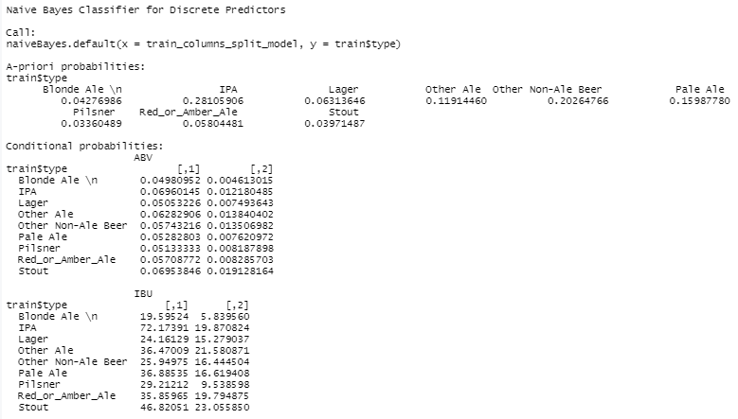
Naive Bayes Classifier for Discrete Predictors (iterations= 50)
Mean Accuracy:
.44.99%
Mean Sensitivity:
61.68%
Mean Specificity:
86.47%

Slide 16
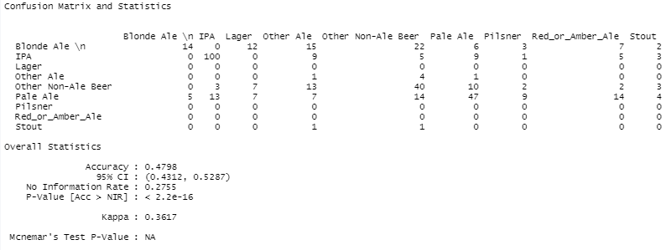
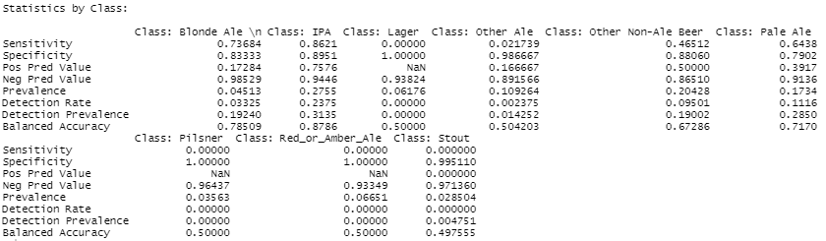
Naive Bayes Classifier for Discrete Predictors (iterations= 50)

